Slide 1
W4111 – Introduction to Databases Section 002, Fall 2023 Lecture 9: Module II, NoSQL, Part 2
© Donald F. Ferguson, 2023

Slide 2

Contents
2 | COMS W4111_002_2023_3: Lecture_9_ Module_II_NoSQL_2 © Donald F. Ferguson, 2023

Slide 3
ER Modeling Aggregation
3 | COMS W4111_002_2023_3: Lecture 9: Module II, NoSQL 2 © Donald F. Ferguson, 2023

Slide 4
Aggregation
Consider the ternary relationship proj_guide, which we saw earlier
Suppose we want to record evaluations of a student by a guide on a project

Slide 5
Aggregation (Cont.)
Relationship sets eval_for and proj_guide represent overlapping information
Every eval_for relationship corresponds to a proj_guide relationship
However, some proj_guide relationships may not correspond to any eval_for relationships
So we can’t discard the proj_guide relationship
Eliminate this redundancy via aggregation
Treat relationship as an abstract entity
Allows relationships between relationships
Abstraction of relationship into new entity

Slide 6
Aggregation (Cont.)
Eliminate this redundancy via aggregation without introducing redundancy, the following diagram represents:
A student is guided by a particular instructor on a particular project
A student, instructor, project combination may have an associated evaluation
Notes:
6

Slide 7
Reduction to Relational Schemas
To represent aggregation, create a schema containing
Primary key of the aggregated relationship,
The primary key of the associated entity set
Any descriptive attributes
In our example:
The schema eval_for is:
eval_for (s_ID, project_id, i_ID, evaluation_id)
The schema proj_guide is redundant.

Slide 8
Module II and NoSQL
(Continued Part 2)
8 | COMS W4111_002_2023_3: Lecture 9: Module II, NoSQL 2 © Donald F. Ferguson, 2023

Slide 9

Reminder
9 | COMS W4111_002_2023_3: Lecture 9: Module II, NoSQL 2 © Donald F. Ferguson, 2023

Slide 10

Course Modules – Reminder

Slide 11
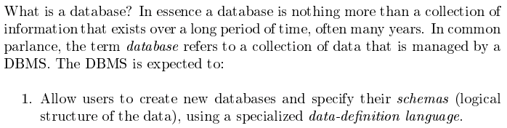
Module II – DBMS Architecture and Implementation
Covered for the relational model.
Database Systems: The Complete Book (2nd Edition) by Hector Garcia-Molina (Author), Jeffrey D. Ullman (Author), Jennifer Widom (Author)

Slide 12
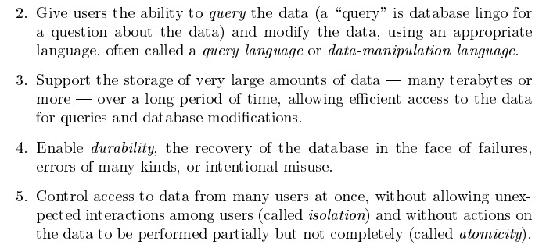
Module II – DBMS Architecture and Implementation
Database Systems: The Complete Book (2nd Edition) by Hector Garcia-Molina (Author), Jeffrey D. Ullman (Author), Jennifer Widom (Author)

Slide 13
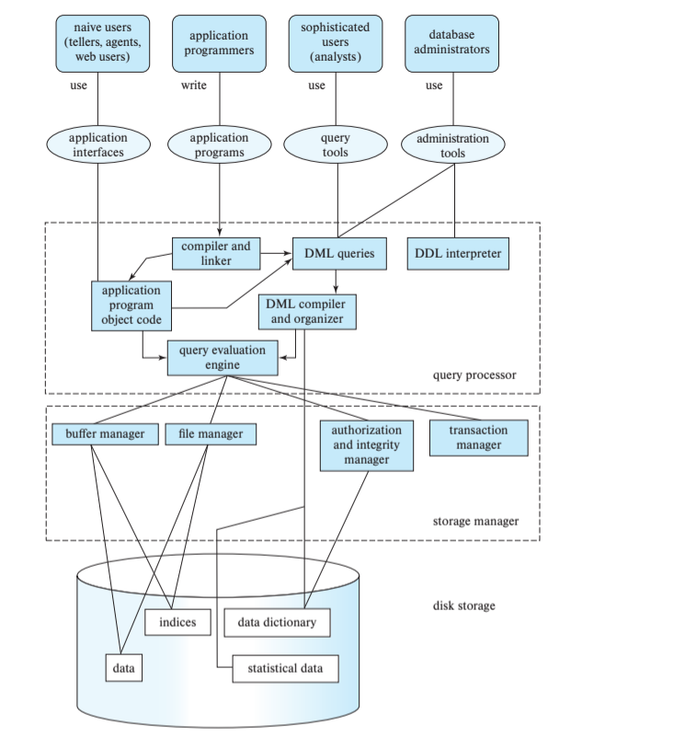
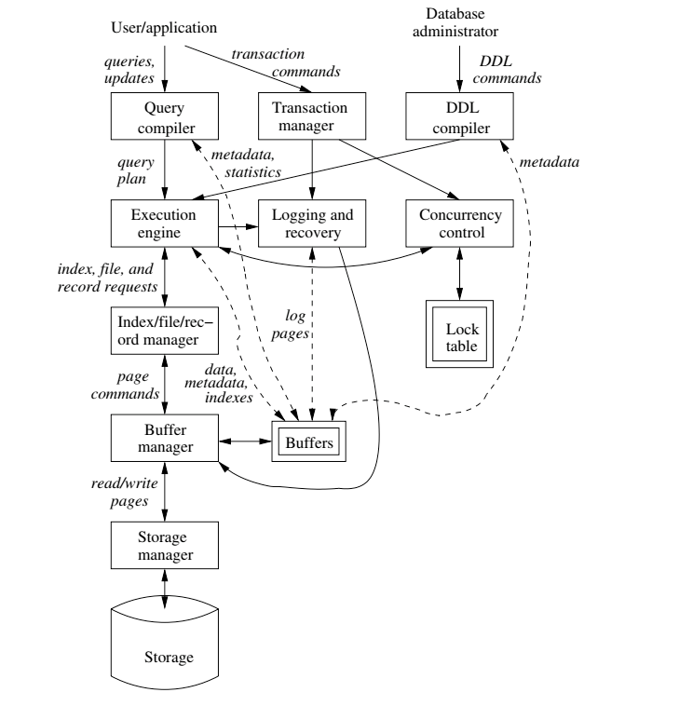
DBMS Arch.

Slide 14

Data Management
Today
Load/save things quickly.
Find things quickly.
Database Systems: The Complete Book (2nd Edition) by Hector Garcia-Molina (Author), Jeffrey D. Ullman (Author), Jennifer Widom (Author)

Slide 15
Data Storage Structures (Database Systems Concepts, V7, Ch. 13)
15 | COMS W4111_002_2023_3: Lecture 9: Module II, NoSQL 2 © Donald F. Ferguson, 2023

Slide 16
File Organization
The database is stored as a collection of files. Each file is a sequence of records. A record is a sequence of fields.
One approach
Assume record size is fixed
Each file has records of one particular type only
Different files are used for different relations
This case is easiest to implement; will consider variable length records later
We assume that records are smaller than a disk block
.
From: Database System Concepts, 7th Ed.

Slide 17
Terminology
A tuple in a relation maps to a record. Records may be
Fixed length
Variable length
Variable format (which we will see in Neo4J, DynamoDB, etc).
A block
Is the unit of transfer between disks and memory (buffer pools).
Contains multiple records, usually but not always from the same relation.
The database address space contains
All of the blocks and records that the database manages
Including blocks/records containing data
And blocks/records containing free space.

Slide 18
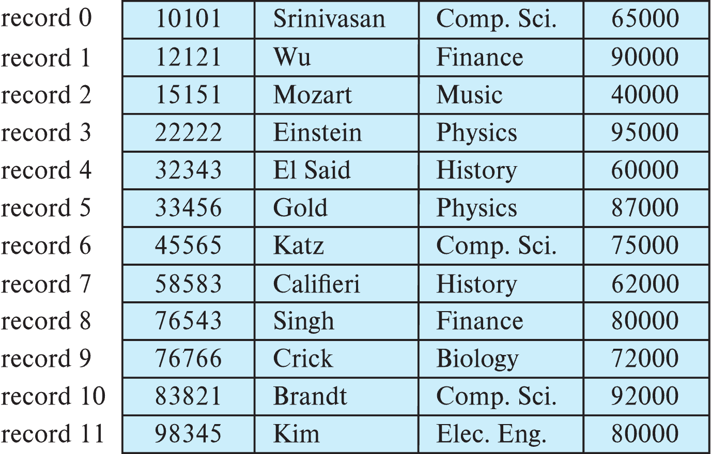
Fixed-Length Records
Simple approach:
Store record i starting from byte n ∗ (i – 1), where n is the size of each record.
Record access is simple but records may cross blocks
Modification: do not allow records to cross block boundaries
From: Database System Concepts, 7th Ed.

Slide 19
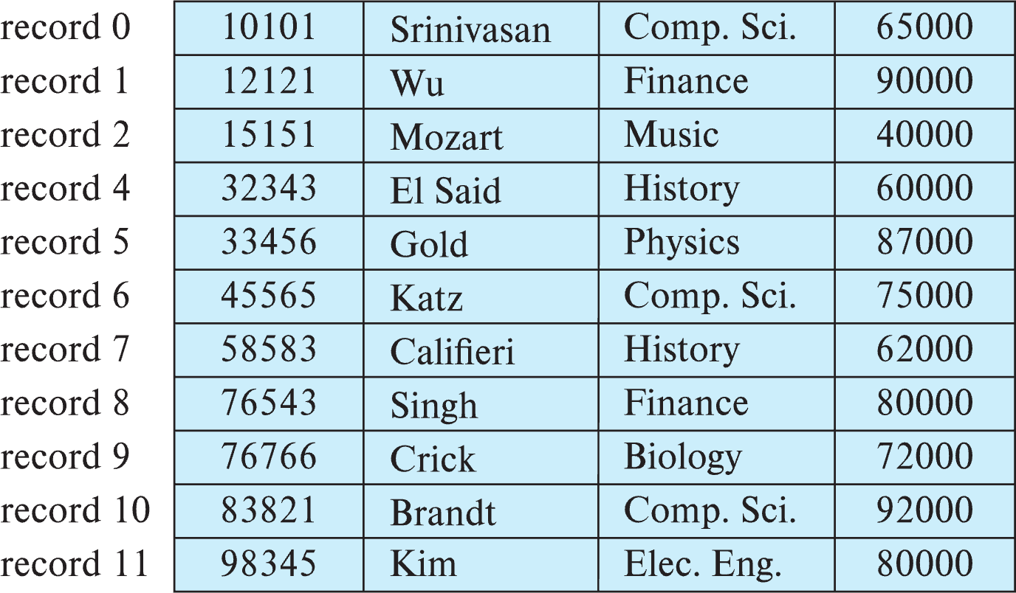
Fixed-Length Records
Deletion of record i: alternatives:
move records i + 1, . . ., n to i, . . . , n – 1
move record n to i
do not move records, but link all free records on a free list
Record 3 deleted
From: Database System Concepts, 7th Ed.

Slide 20
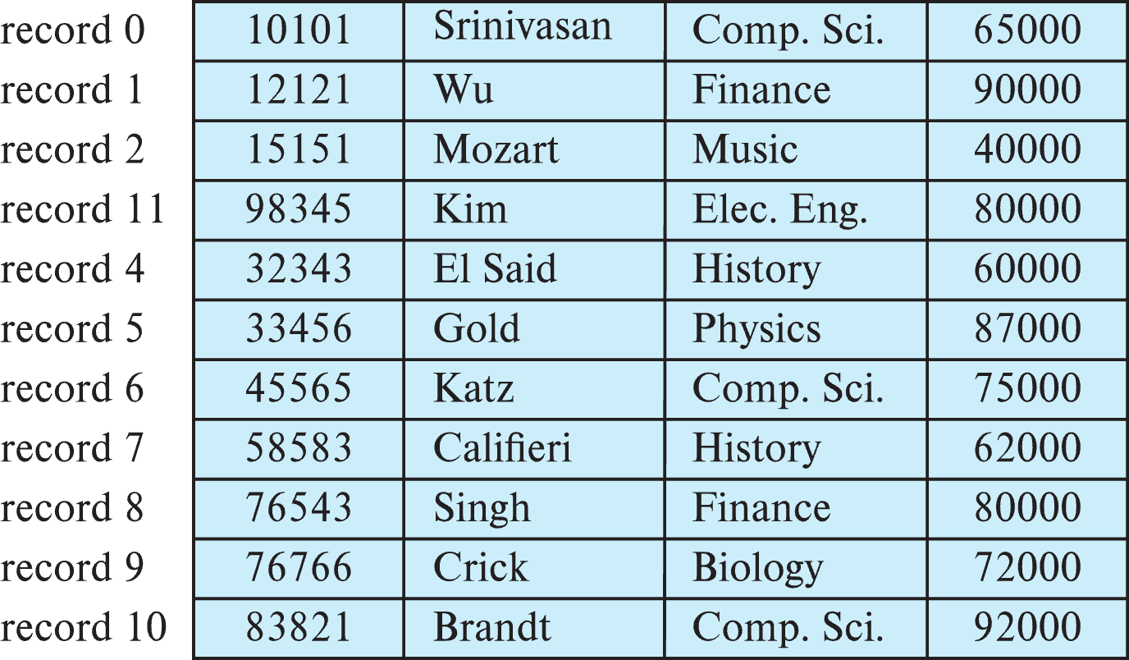
Fixed-Length Records
Deletion of record i: alternatives:
move records i + 1, . . ., n to i, . . . , n – 1
move record n to i
do not move records, but link all free records on a free list
Record 3 deleted and replaced by record 11
From: Database System Concepts, 7th Ed.

Slide 21
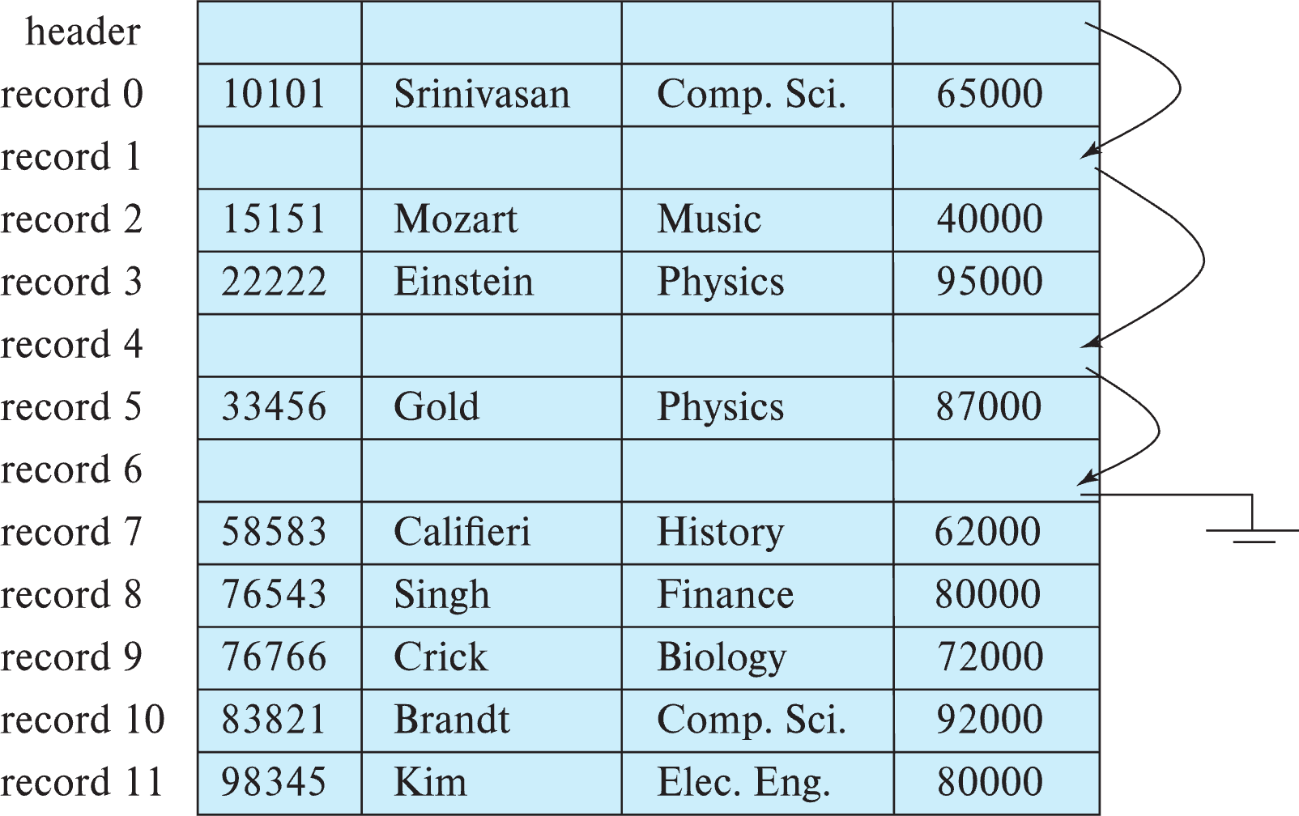
Fixed-Length Records
Deletion of record i: alternatives:
move records i + 1, . . ., n to i, . . . , n – 1
move record n to i
do not move records, but link all free records on a free list
From: Database System Concepts, 7th Ed.

Slide 22
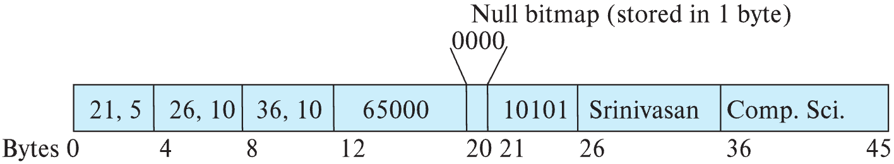
Variable-Length Records
Variable-length records arise in database systems in several ways:
Storage of multiple record types in a file.
Record types that allow variable lengths for one or more fields such as strings (varchar)
Record types that allow repeating fields (used in some older data models).
Attributes are stored in order
Variable length attributes represented by fixed size (offset, length), with actual data stored after all fixed length attributes
Null values represented by null-value bitmap
From: Database System Concepts, 7th Ed.

Slide 23
Variable-Length Records: Slotted Page Structure
Slotted page header contains:
number of record entries
end of free space in the block
location and size of each record
Records can be moved around within a page to keep them contiguous with no empty space between them; entry in the header must be updated.
Pointers should not point directly to record — instead they should point to the entry for the record in header.
From: Database System Concepts, 7th Ed.

Slide 24
Storing Large Objects
E.g., blob/clob types
Records must be smaller than pages
Alternatives:
Store as files in file systems
Store as files managed by database
Break into pieces and store in multiple tuples in separate relation
PostgreSQL TOAST
From: Database System Concepts, 7th Ed.

Slide 25
Organization of Records in Files
Heap – record can be placed anywhere in the file where there is space
Sequential – store records in sequential order, based on the value of the search key of each record
In a multitable clustering file organization records of several different relations can be stored in the same file
Motivation: store related records on the same block to minimize I/O
B⁺-tree file organization
Ordered storage even with inserts/deletes
More on this in Chapter 14
Hashing – a hash function computed on search key; the result specifies in which block of the file the record should be placed
More on this in Chapter 14
From: Database System Concepts, 7th Ed.

Slide 26
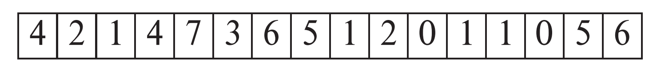
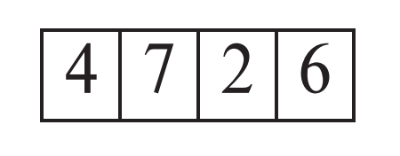
Heap File Organization
Records can be placed anywhere in the file where there is free space
Records usually do not move once allocated
Important to be able to efficiently find free space within file
Free-space map
Array with 1 entry per block. Each entry is a few bits to a byte, and records fraction of block that is free
In example below, 3 bits per block, value divided by 8 indicates fraction of block that is free
Can have second-level free-space map
In example below, each entry stores maximum from 4 entries of first-level free-space map
Free space map written to disk periodically, OK to have wrong (old) values for some entries (will be detected and fixed)
From: Database System Concepts, 7th Ed.

Slide 27
Sequential File Organization
Suitable for applications that require sequential processing of the entire file
The records in the file are ordered by a search-key
From: Database System Concepts, 7th Ed.

Slide 28
Sequential File Organization (Cont.)
Deletion – use pointer chains
Insertion –locate the position where the record is to be inserted
if there is free space insert there
if no free space, insert the record in an overflow block
In either case, pointer chain must be updated
Need to reorganize the file from time to time to restore sequential order
From: Database System Concepts, 7th Ed.
From: Database System Concepts, 7th Ed.

Slide 29
Partitioning
Table partitioning: Records in a relation can be partitioned into smaller relations that are stored separately
E.g., transaction relation may be partitioned into transaction_2018, transaction_2019, etc.
Queries written on transaction must access records in all partitions
Unless query has a selection such as year=2019, in which case only one partition in needed
Partitioning
Reduces costs of some operations such as free space management
Allows different partitions to be stored on different storage devices
E.g., transaction partition for current year on SSD, for older years on magnetic disk
From: Database System Concepts, 7th Ed.

Slide 30
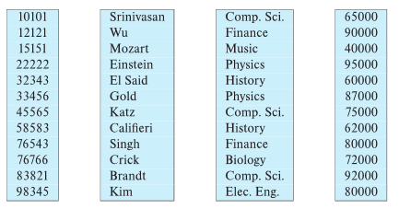
Column-Oriented Storage
Also known as columnar representation
Store each attribute of a relation separately
Example
From: Database System Concepts, 7th Ed.

Slide 31
Columnar Representation
Benefits:
Reduced IO if only some attributes are accessed
Improved CPU cache performance
Improved compression
Vector processing on modern CPU architectures
Drawbacks
Cost of tuple reconstruction from columnar representation
Cost of tuple deletion and update
Cost of decompression
Columnar representation found to be more efficient for decision support than row-oriented representation
Traditional row-oriented representation preferable for transaction processing
Some databases support both representations
Called hybrid row/column stores
From: Database System Concepts, 7th Ed.

Slide 32
Row vs Column
Columnar and Row are both
Relational
Support SQL operations
But differ in data storage
Row keeps row data together in blocks.
Columnar keys column data together in blocks.
This determines performance for different types of query, e.g.
Columnar is extremely powerful for BI scenarios
Aggregation ops, e.g. SUM, AVG
PROJECT (do not load all of the row) to get a few columns
Row is powerful for OLTP. Transaction typically create and retrieve
One row at a time
All the columns of a single row.

Slide 33
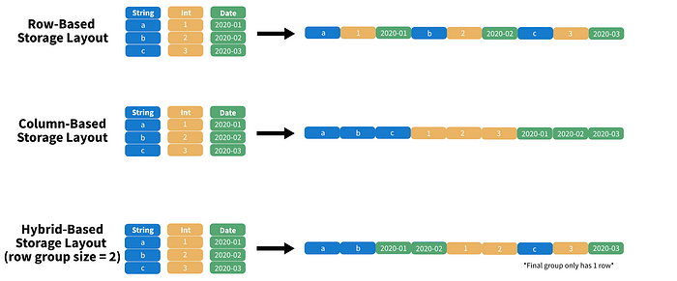
Columnar File Representation
https://towardsdatascience.com/demystifying-the-parquet-file-format-13adb0206705
Apache parquet is an open-source file format that provides efficient storage and fast read speed. It uses a hybrid storage format which sequentially stores chunks of columns, lending to high performance when selecting and filtering data. On top of strong compression algorithm support (snappy, gzip, LZO), it also provides some clever tricks for reducing file scans and encoding repeat variables.

Slide 34
Indexes
34 | COMS W4111_002_2023_1 - Lecture 9: Module II, NoSQL, Graph DBs © Donald F. Ferguson, 2023

Slide 35
Basic Concepts
Indexing mechanisms used to speed up access to desired data.
E.g., author catalog in library
Search Key - attribute to set of attributes used to look up records in a file.
An index file consists of records (called index entries) of the form
Index files are typically much smaller than the original file
Two basic kinds of indices:
Ordered indices: search keys are stored in sorted order
Hash indices: search keys are distributed uniformly across “buckets” using a “hash function”.
search-key
pointer

Slide 36
Ordered Indices
In an ordered index, index entries are stored sorted on the search key value.
Clustering index: in a sequentially ordered file, the index whose search key specifies the sequential order of the file.
Also called primary index
The search key of a primary index is usually but not necessarily the primary key.
Secondary index: an index whose search key specifies an order different from the sequential order of the file. Also called nonclustering index.
Index-sequential file: sequential file ordered on a search key, with a clustering index on the search key.

Slide 37
Dense Index Files
Dense index — Index record appears for every search-key value in the file.
E.g. index on ID attribute of instructor relation

Slide 38
Dense Index Files (Cont.)
Dense index on dept_name, with instructor file sorted on dept_name

Slide 39
Sparse Index Files
Sparse Index: contains index records for only some search-key values.
Applicable when records are sequentially ordered on search-key
To locate a record with search-key value K we:
Find index record with largest search-key value < K
Search file sequentially starting at the record to which the index record points

Slide 40
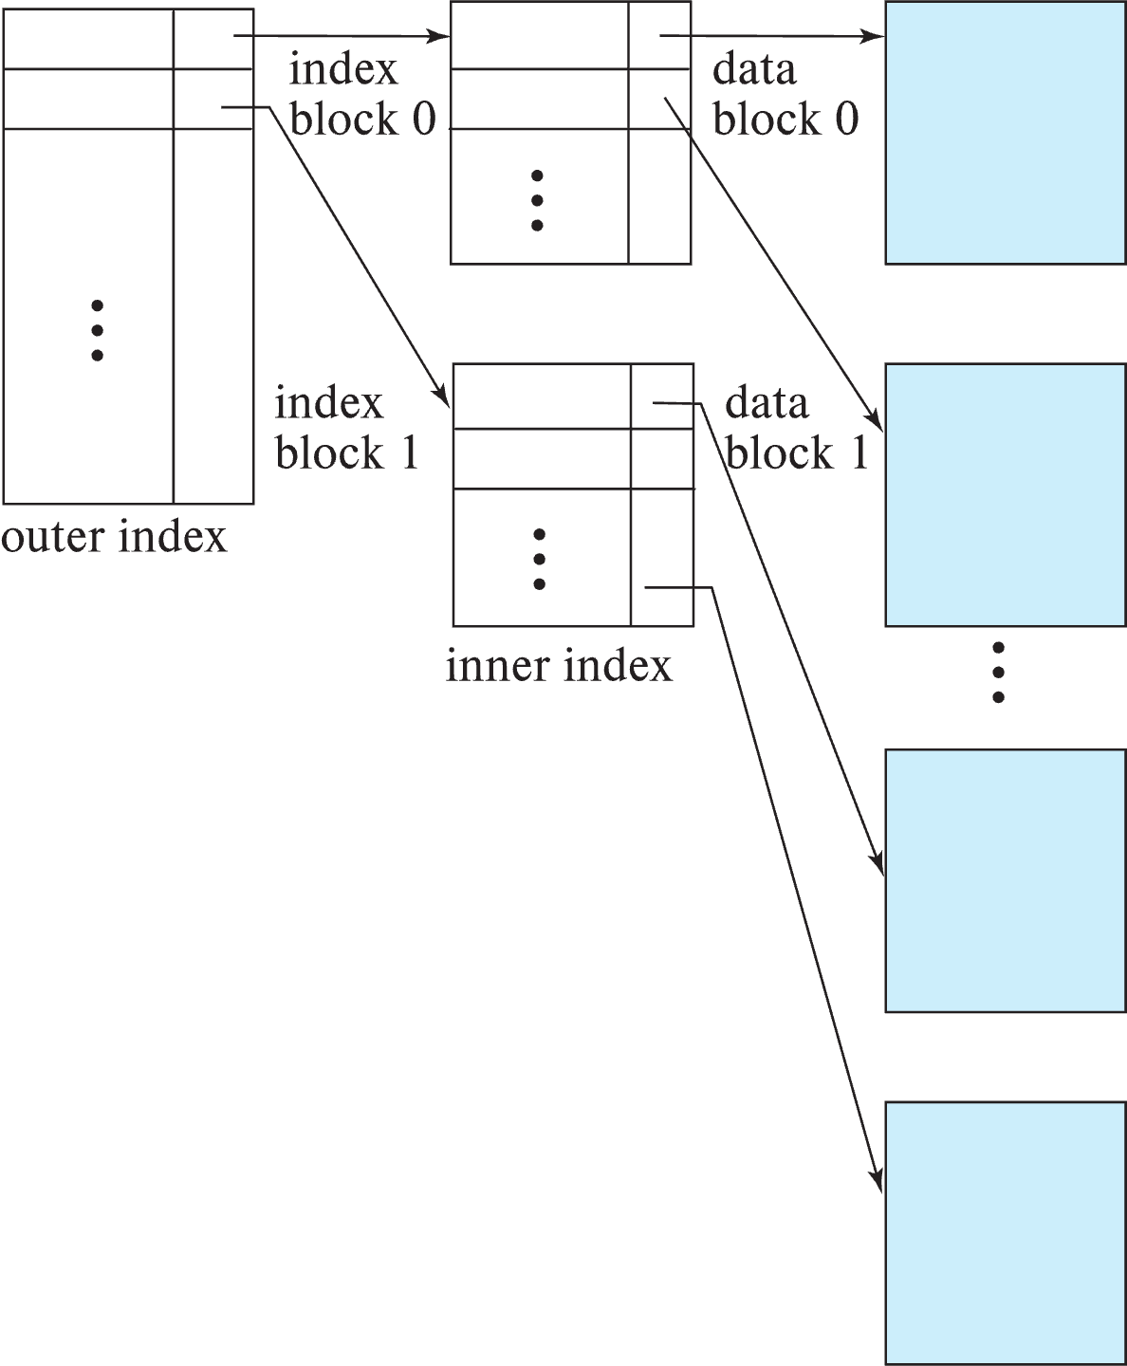
Sparse Index Files (Cont.)
Compared to dense indices:
Less space and less maintenance overhead for insertions and deletions.
Generally slower than dense index for locating records.
Good tradeoff:
for clustered index: sparse index with an index entry for every block in file, corresponding to least search-key value in the block.
For unclustered index: sparse index on top of dense index (multilevel index)

Slide 41
Secondary Indices Example
Secondary index on salary field of instructor
Index record points to a bucket that contains pointers to all the actual records with that particular search-key value.
Secondary indices have to be dense

Slide 42
Clustering vs Nonclustering Indices
Indices offer substantial benefits when searching for records.
BUT: indices imposes overhead on database modification
when a record is inserted or deleted, every index on the relation must be updated
When a record is updated, any index on an updated attribute must be updated
Sequential scan using clustering index is efficient, but a sequential scan using a secondary (nonclustering) index is expensive on magnetic disk
Each record access may fetch a new block from disk
Each block fetch on magnetic disk requires about 5 to 10 milliseconds

Slide 43
Indices on Multiple Keys
Composite search key
E.g., index on instructor relation on attributes (name, ID)
Values are sorted lexicographically
E.g. (John, 12121) < (John, 13514) and (John, 13514) < (Peter, 11223)
Can query on just name, or on (name, ID)
(nameLast, nameFirst, birthyear)
nameLast [nameLast = “Ferguson”] [nameLast like “Fer%”]
nameLast, nameFirst
nameLast, nameFirst, birthyear
NOT and index on
nameFirst, nameLast
birthyear
nameLast like [%er%]

Slide 44
B⁺-Tree Index Files
Disadvantage of indexed-sequential files
Performance degrades as file grows, since many overflow blocks get created.
Periodic reorganization of entire file is required.
Advantage of B⁺-tree index files:
Automatically reorganizes itself with small, local, changes, in the face of insertions and deletions.
Reorganization of entire file is not required to maintain performance.
(Minor) disadvantage of B⁺-trees:
Extra insertion and deletion overhead, space overhead.
Advantages of B⁺-trees outweigh disadvantages
B⁺-trees are used extensively

Slide 45
Example of B⁺-Tree

Slide 46
B⁺-Tree Index Files (Cont.)
A B⁺-tree is a rooted tree satisfying the following properties:
All paths from root to leaf are of the same length
Each node that is not a root or a leaf has between ⎡n/2⎤ and n children.
A leaf node has between ⎡(n–1)/2⎤ and n–1 values
Special cases:
If the root is not a leaf, it has at least 2 children.
If the root is a leaf (that is, there are no other nodes in the tree), it can have between 0 and (n–1) values.

Slide 47
B⁺-Tree Node Structure
Typical node
K_{i} are the search-key values
P_{i} are pointers to children (for non-leaf nodes) or pointers to records or buckets of records (for leaf nodes).
The search-keys in a node are ordered
K₁ < K₂ < K₃ < . . . < K_{n–1}
(Initially assume no duplicate keys, address duplicates later)

Slide 48
Leaf Nodes in B⁺-Trees
Properties of a leaf node:
For i = 1, 2, . . ., n–1, pointer P_{i} points to a file record with search-key value K_{i},
If L_{i}, L_{j} are leaf nodes and i < j, L_{i}’s search-key values are less than or equal to L_{j}’s search-key values
P_{n} points to next leaf node in search-key order

Slide 49
Non-Leaf Nodes in B⁺-Trees
Non leaf nodes form a multi-level sparse index on the leaf nodes. For a non-leaf node with m pointers:
All the search-keys in the subtree to which P₁ points are less than K₁
For 2 ≤ i ≤ n – 1, all the search-keys in the subtree to which P_{i} points have values greater than or equal to K_{i–1} and less than K_{i}
All the search-keys in the subtree to which P_{n} points have values greater than or equal to K_{n–1}
General structure

Slide 50
Example of B⁺-tree
B⁺-tree for instructor file (n = 6)
Leaf nodes must have between 3 and 5 values (⎡(n–1)/2⎤ and n –1, with n = 6).
Non-leaf nodes other than root must have between 3 and 6 children (⎡(n/2⎤ and n with n =6).
Root must have at least 2 children.

Slide 51
Observations about B⁺-trees
Since the inter-node connections are done by pointers, “logically” close blocks need not be “physically” close.
The non-leaf levels of the B⁺-tree form a hierarchy of sparse indices.
The B⁺-tree contains a relatively small number of levels
Level below root has at least 2* ⎡n/2⎤ values
Next level has at least 2* ⎡n/2⎤ * ⎡n/2⎤ values
.. etc.
If there are K search-key values in the file, the tree height is no more than ⎡ log_{⎡n/2⎤}(K)⎤
thus searches can be conducted efficiently.
Insertions and deletions to the main file can be handled efficiently, as the index can be restructured in logarithmic time (as we shall see).

Slide 52
Show the Simulator
https://www.cs.usfca.edu/~galles/visualization/BPlusTree.html

Slide 53
Hashing

Slide 54
Static Hashing
A bucket is a unit of storage containing one or more entries (a bucket is typically a disk block).
we obtain the bucket of an entry from its search-key value using a hash function
Hash function h is a function from the set of all search-key values K to the set of all bucket addresses B.
Hash function is used to locate entries for access, insertion as well as deletion.
Entries with different search-key values may be mapped to the same bucket; thus entire bucket has to be searched sequentially to locate an entry.
In a hash index, buckets store entries with pointers to records
In a hash file-organization buckets store records

Slide 55
Handling of Bucket Overflows (Cont.)
Overflow chaining – the overflow buckets of a given bucket are chained together in a linked list.
Above scheme is called closed addressing (also called closed hashing or open hashing depending on the book you use)
An alternative, called open addressing (also called open hashing or closed hashing depending on the book you use) which does not use over- flow buckets, is not suitable for database applications.

Slide 56
Example of Hash File Organization
Hash file organization of instructor file, using dept_name as key.

Slide 57
Deficiencies of Static Hashing
In static hashing, function h maps search-key values to a fixed set of B of bucket addresses. Databases grow or shrink with time.
If initial number of buckets is too small, and file grows, performance will degrade due to too much overflows.
If space is allocated for anticipated growth, a significant amount of space will be wasted initially (and buckets will be underfull).
If database shrinks, again space will be wasted.
One solution: periodic re-organization of the file with a new hash function
Expensive, disrupts normal operations
Better solution: allow the number of buckets to be modified dynamically.

Slide 58
Show the Simulator
http://iswsa.acm.org/mphf/openDSAPerfectHashAnimation/perfectHashAV.html
https://opendsa-server.cs.vt.edu/ODSA/AV/Development/hashAV.html

Slide 59
NoSQL
59 | COMS W4111_002_2023_3: Lecture 9: Module II, NoSQL 2 © Donald F. Ferguson, 2023

Slide 60
Concepts
60 | COMS W4111_002_2023_3: Lecture 9: Module II, NoSQL 2 © Donald F. Ferguson, 2023

Slide 61
Overview (I) (https://en.wikipedia.org/wiki/NoSQL)
A NoSQL (originally referring to "non SQL" or "non relational")^{[1]} database provides a mechanism for storage and retrieval of data that is modeled in means other than the tabular relations used in relational databases. Such databases have existed since the late 1960s, but did not obtain the "NoSQL" moniker until a surge of popularity in the early twenty-first century,^{[2]} triggered by the needs of Web 2.0 companies such as Facebook, Google, and Amazon.com.^{[3][4][5]} NoSQL databases are increasingly used in big data and real-time web applications.^{[6]} NoSQL systems are also sometimes called "Not only SQL" to emphasize that they may support SQL-like query languages.^{[7][8]}
Motivations for this approach include: simplicity of design, simpler "horizontal" scaling to clusters of machines (which is a problem for relational databases),^{[2]} and finer control over availability. The data structures used by NoSQL databases (e.g. key-value, wide column, graph, or document) are different from those used by default in relational databases, making some operations faster in NoSQL. The particular suitability of a given NoSQL database depends on the problem it must solve. Sometimes the data structures used by NoSQL databases are also viewed as "more flexible" than relational database tables.^{[9]}

Slide 62
Overview (I) (https://en.wikipedia.org/wiki/NoSQL)
Many NoSQL stores compromise consistency (in the sense of the CAP theorem) in favor of availability, partition tolerance, and speed. Barriers to the greater adoption of NoSQL stores include the use of low-level query languages (instead of SQL, for instance the lack of ability to perform ad-hoc joins across tables), lack of standardized interfaces, and huge previous investments in existing relational databases.^{[10]} Most NoSQL stores lack true ACID transactions, … …
Instead, most NoSQL databases offer a concept of "eventual consistency" in which database changes are propagated to all nodes "eventually" (typically within milliseconds) so queries for data might not return updated data immediately or might result in reading data that is not accurate, a problem known as stale reads.^{[11]} Additionally, some NoSQL systems may exhibit lost writes and other forms of data loss.^{[12]} Fortunately, some NoSQL systems provide concepts such as write-ahead logging to avoid data loss.^{[13]} For distributed transaction processing across multiple databases, data consistency is an even bigger challenge that is difficult for both NoSQL and relational databases. Even current relational databases "do not allow referential integrity constraints to span databases."^{[14]}

Slide 63
Simplistic Classification (https://medium.com/swlh/4-types-of-nosql-databases-d88ad21f7d3b)
Relational is the foundational model.
We will see OLAP in a future lecture.
Subject of this lecture and part of HW4
We covered graphs and examples.

Slide 64
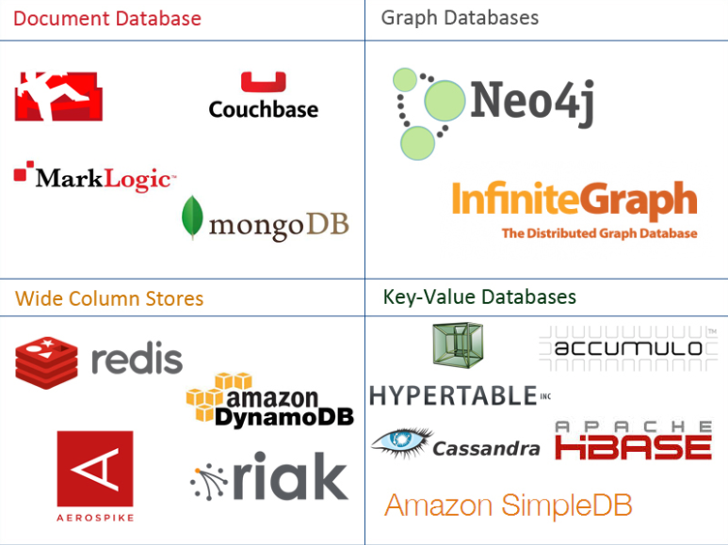
One Taxonomy

Slide 65
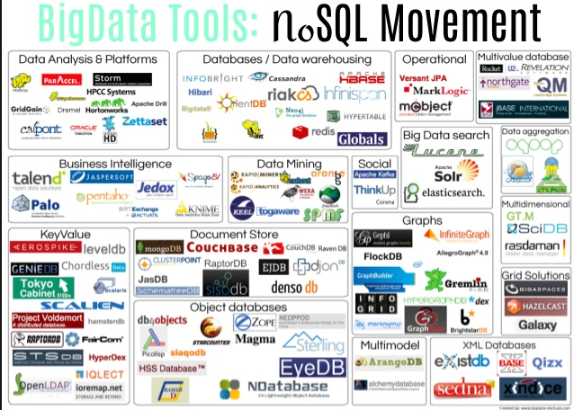
Another Taxonomy

Slide 66
Use Cases
Motivations
Massive write performance.
Fast key value look ups.
Flexible schema and data types.
No single point of failure.
Fast prototyping and development.
Out of the box scalability.
Easy maintenance.
What is wrong with SQL/Relational?
Nothing. One size fits all? Not really.
Impedance mismatch. – Object Relational Mapping doesn’t work quite well.
Rigid schema design.
Harder to scale.
Replication.
Joins across multiple nodes? Hard.
How does RDMS handle data growth? Hard.
Need for a DBA.
Many programmers are already familiar with it.
Transactions and ACID make development easy.
Lots of tools to use.

Slide 67
Documents
67 | COMS W4111_002_2023_3: Lecture 9: Module II, NoSQL 2 © Donald F. Ferguson, 2023

Slide 68

Example Document – An Order
There are 5 entity types on the form:
A “copy of” customer information.
Links (via productCode) to products
Order
OrderDetails
Comments
But OrderDetails and Comments are somehow different from the others.
These are arrays of objects
That are sort of “inside” the order.
These are weak entities, but relational does not always handle these well.

Slide 69
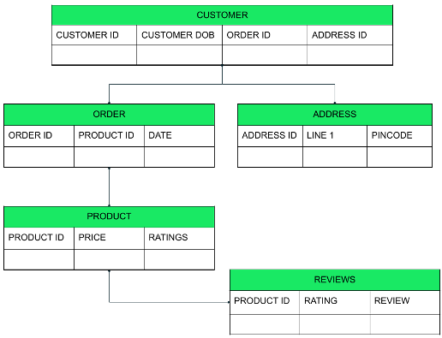
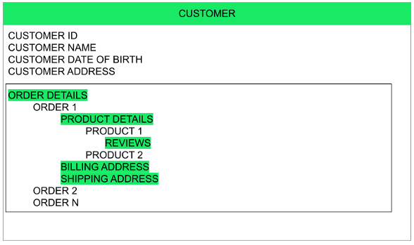
Relational vs Document
Relational
Relational
The key difference?
Relational DB attributes are atomic.
Document DB attributes may be multi-valued and complex.

Slide 70
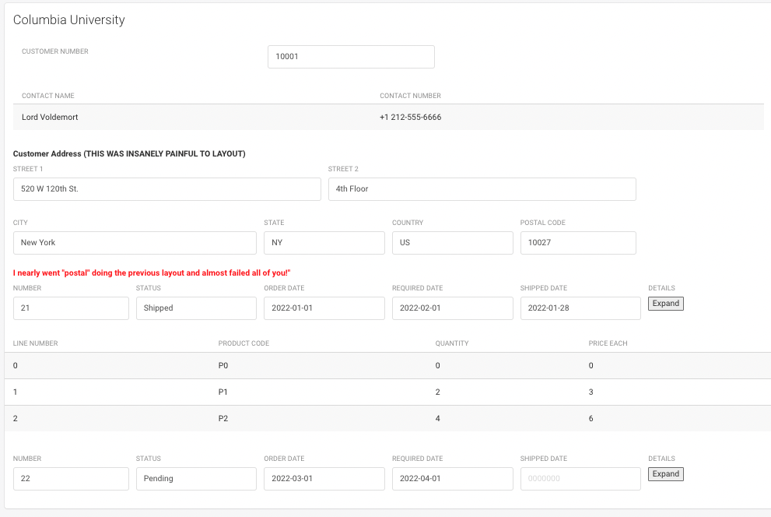
UI Interface and Logical Data Model
{
customerName: “Columbia University”,
contact: {
name: “Lord Voldemort”,
phone: “+1 212-555-6666”
},
address: {
line1: “520 W 120th St.”
line2: “Floor 4”,
… …
}
orders: [
{
number: …,
… …
details: [
… …
]
}
]
}

Slide 71
Switch to Notebook

Slide 72
MongoDB
72 | COMS W4111_002_2023_3: Lecture 9: Module II, NoSQL 2 © Donald F. Ferguson, 2023

Slide 73
MongoDB Concepts
RDBMS | MongoDB | MongoDB
Database | Database | Database
Table | Collection | Collection
Tuple/Row | Document | Document
column | Field | Field
Table Join | Embedded Documents | Embedded Documents
Primary Key | Primary Key (Default key _id provided by MongoDB itself) | Primary Key (Default key _id provided by MongoDB itself)
Database Server, Client, Tools, Packages
mysqld/Oracle |  | mongod
mysql/sqlplus |  | mongo
DataGrip |  | Compass
pymysql |  | pymongo

Slide 74
Core Operations
Basic Operations:
Create database
Create collection
Create-Retrieve-Update-Delete (CRUD):
Create: insert()
Retrieve:
find()
find_one()
Update: update()
Delete: remove()
More Advanced Concepts:
Limit
Sort
Aggregation Pipelines
Merge
Union
Lookup
Match
Merge
Sample
... ...
We will just cover the basics for now and may cover more things in HW or other lectures.

Slide 75
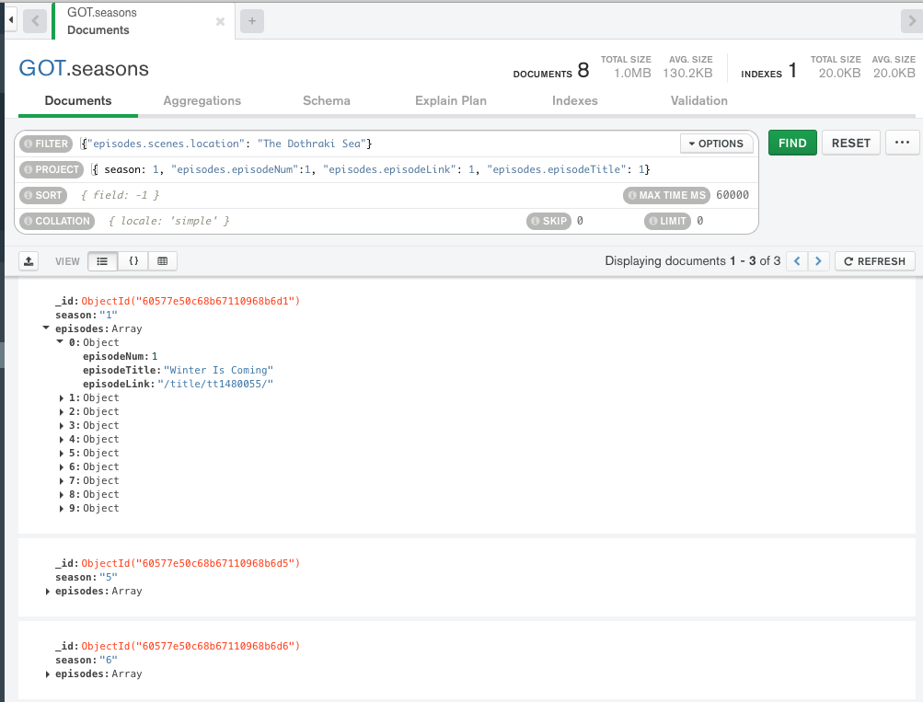
find()
Note:
MongoDB uses a more pymysql approach, e.g. an API, than pure declarative languages like SQL.
The parameters for find() are where the declarative language appears.
The basic forms of find() and find_one() have two parameters:
filter expression
Project expression
You can use the Compass tool and screen captures for some HW and exam answers.
What if I want the answer in a Jupyter Notebook?

Slide 76
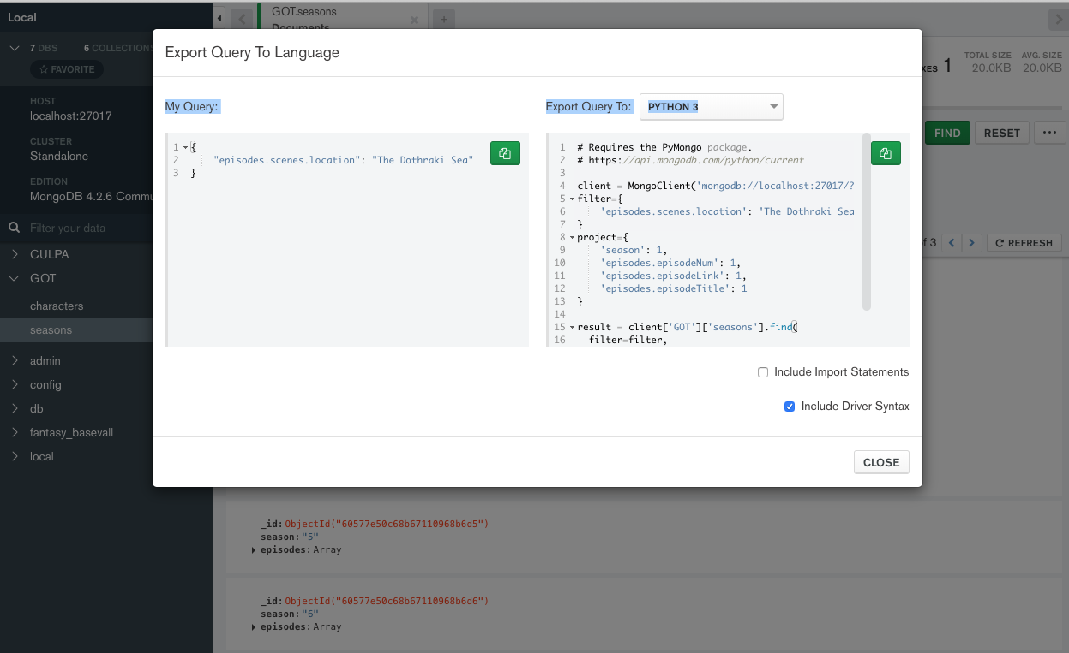
Generate Code
Choose Export to Language.
Copy into the notebook.
The export has an option to include all the connection setup, choosing DB, ... ...
Switch to Notebook

Slide 77
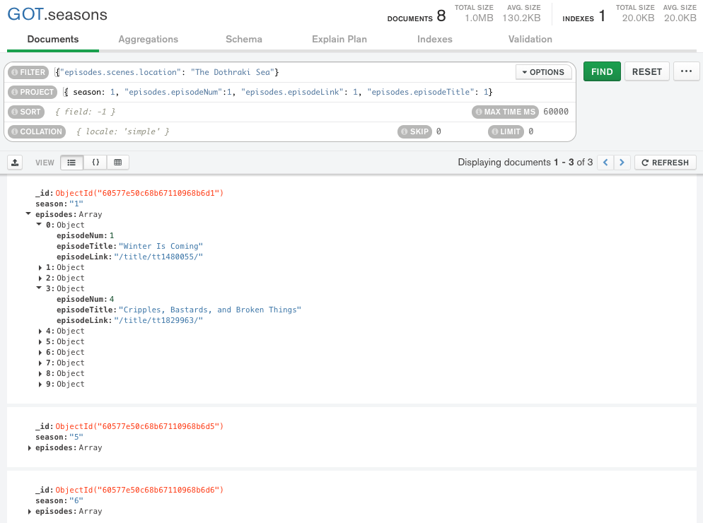
Result is not Quite You Expect
The query returns documents that match.
The document is “Large” and has and episodes and seasons.
If you do a $project requesting episodes/episode content,
You get all episodes in the documents that match.
Not just the episodes with the scene/location.
Projecting array elements from arrays whose elements are arrays is complex and baffling.
You also get back something (a cursor) that is iterable.

Slide 78
Result is not Quite You Expect
The query returns documents that match.
The document is “Large” and has and episodes and seasons.
If you do a $project requesting episodes/episode content,
You get all episodes in the documents that match.
Not just the episodes with the scene/location.
Projecting array elements from arrays whose elements are arrays is complex and baffling.
You also get back something (a cursor) that is iterable.
Net for HWs and exams:
We will keep the queries simple.
The language is as complex as SQL, and we spent several weeks on the language.
Let’s take a look in the Jupyter Notebook on some create and insert functions.
But, first, the datamodel impedance mismatch concept.

Slide 79
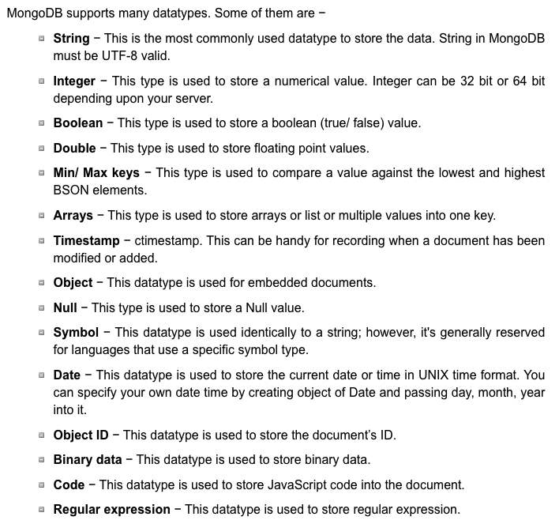
More Fun – Data Types
Python
pymysql
pymongo
SQL
MongoDB

Slide 80
(Some) MongoDB CRUD Operations
Create:
db.collection.insertOne()
db.collection.insertMany()
Retrieve:
db.collection.find()
db.collection.findOne()
db.collection.findOneAndUpdate()
... ..
Update:
db.collection.updateOne()
db.collection.updateMany()
db.collection.replaceOne()
Delete:
db.collection.deleteOne()
db.collection.deleteMany()
pymongo maps the camel case to _, e.g.
findOne()
find_one()
There are good online tutorials:
https://www.tutorialspoint.com/python_data_access
https://www.tutorialspoint.com/mongodb/index.htm

Slide 81
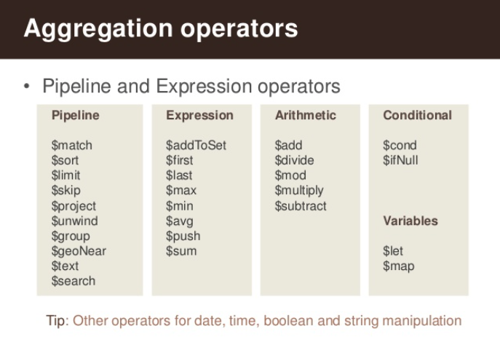
(Some) MongdoDB Pipeline Operators
https://www.slideshare.net/mongodb/s01-e04-analytics

Slide 82
MongoDB Checkpoint
You can see that MongoDB has powerful, sophisticated
Operators
Expressions
Pipelines
We have only skimmed the surface. There is a lot more:
Indexes
Replication, Sharding
Embedded Map-Reduce support
... ...
We will explore a little more in subsequent lectures, homework, ... ...
You will have to install MongoDB and Compass for HW4 and final exam.

